Slide 1

Smart City Solution Mobility in Kowloon East
——team 5

Slide 2
TABLE OF CONTENTS
1
2
3
4
PROBLEM
SOLUTION
TARGET AND COMPETITIVE ANALYSIS
PROTOTYPE SHOWING

Slide 3
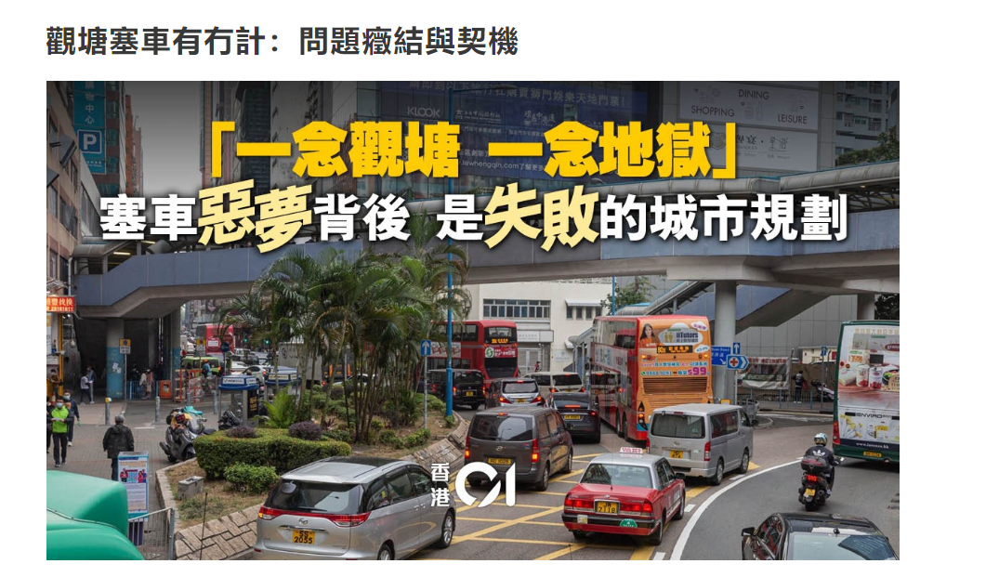
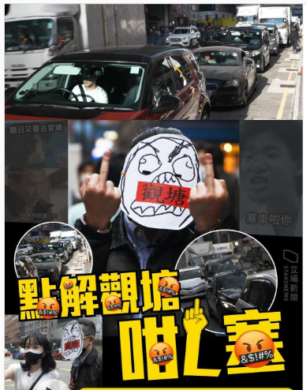
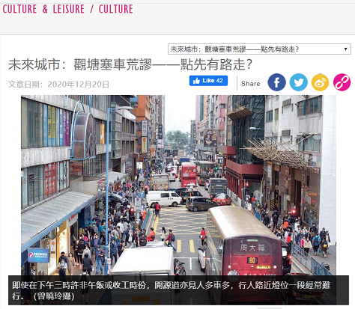
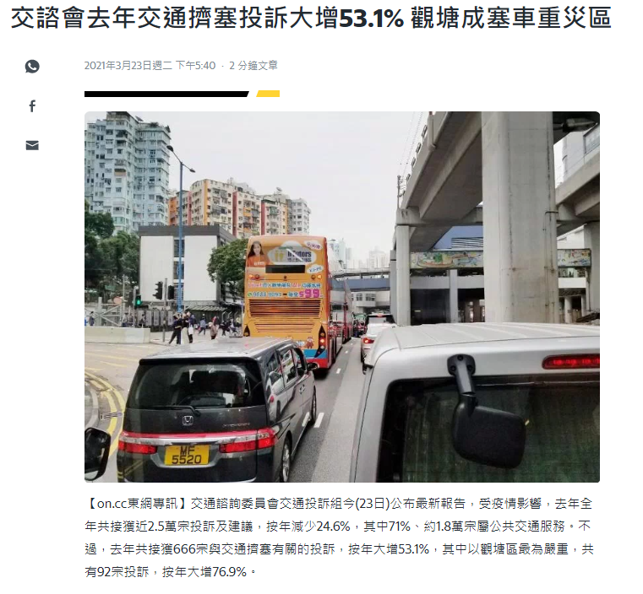
PROBLEM
Kowloon East (KE) is undergoing urban revitalization into the second core business district (CBD) of HK. However, the public is complaining about the traffic especially in the congested Kwun Tong of KE.

Slide 4
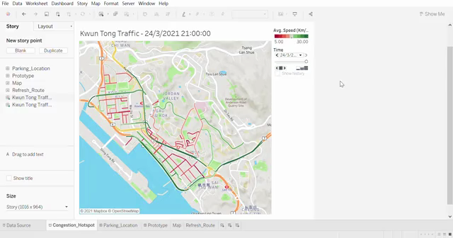
PROBLEM
1. Congestion Hotspot
Industrial Area
residential area
Kwun Tong Industrial Area
historical average traffic conditions (from 7 a.m. to 9 p.m.)

Slide 5
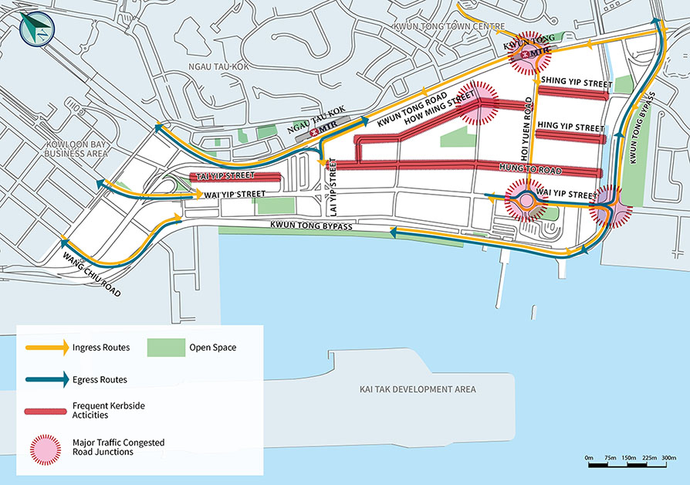
PROBLEM
1. Congestion Hotspot
Kwun Tong Industrial Area
Wai Fat Road/ Wai Yip Street junction, Hoi Yuen Road/ Wai Yip Street junction, Hoi Yuen Road/ Kwun Tong Road junction and How Ming Street/ Tsun Yip Street junction etc.
→Hotstop : Wai Fat Road/ Wai Yip Street junction，Hoi Yuen Road/ Wai Yip Street junction, Hoi Yuen Road/ Kwun Tong Road junction and How Ming Street/ Tsun Yip Street junction etc
Notes:
the heavy traffic flows in Kwun Tong District have caused traffic congestion at some road junctions including Wai Fat Road/ Wai Yip Street junction, Hoi Yuen Road/ Wai Yip Street junction, Hoi Yuen Road/ Kwun Tong Road junction and How Ming Street/ Tsun Yip Street junction etc

Slide 6
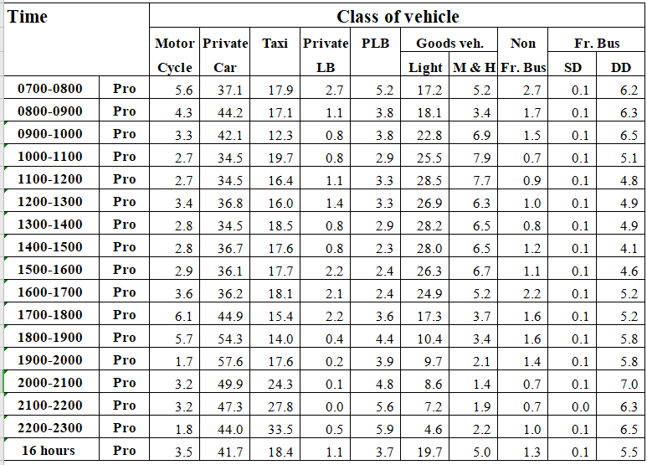
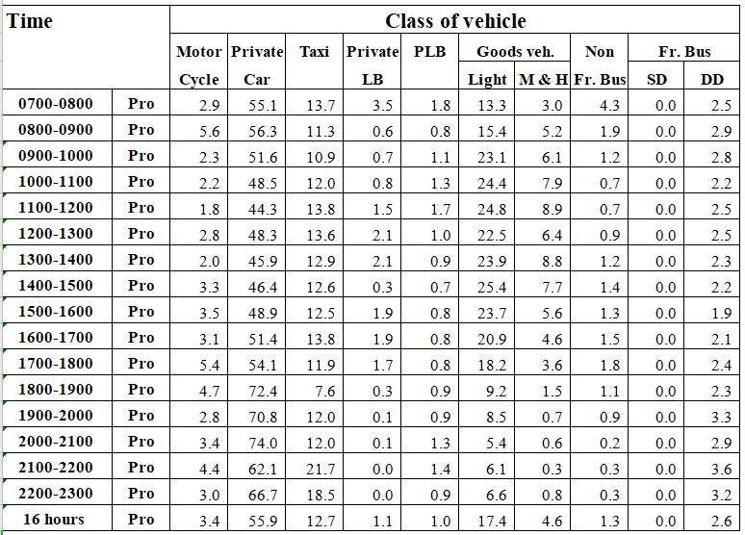
PROBLEM
2. Vehicle classification and occupancy --Monday to Friday
KWUN TONG BYPASS (from KAI YAN ST to LUNG CHEUNG RD)
KWUN TONG RD (from PING SHEK EST EASTERN END to WAI YIP ST FO <K42>)
→Private car account for a large proportion
Notes:
Private car account for a large proportion among all, and also in peak time

Slide 7
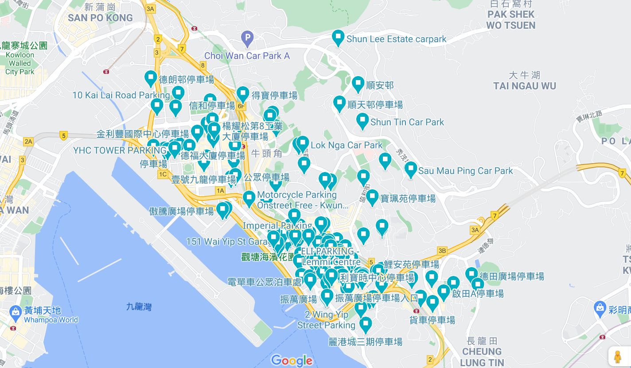
PROBLEM
3. Car Park Distribution
→Most car parks are located in the congestion points

Slide 8
SOLUTIONS
Add road acccess restriction on the identified congestion hotspot (industrial area in Kwun Tong starting from Hoi Yuen Road), to reduce the numbers of private cars on road in peak hours.
X
1
Set up some new car parks far from the congestion roads and near the Green Way Network (an example).
2
P
Promote using e-scooters + multiple transport modes in a journey.
→ Set e-scooters renting service in the car parks.
→ Introduce an app helping e-scooter users to plan their journey.
3

Slide 9
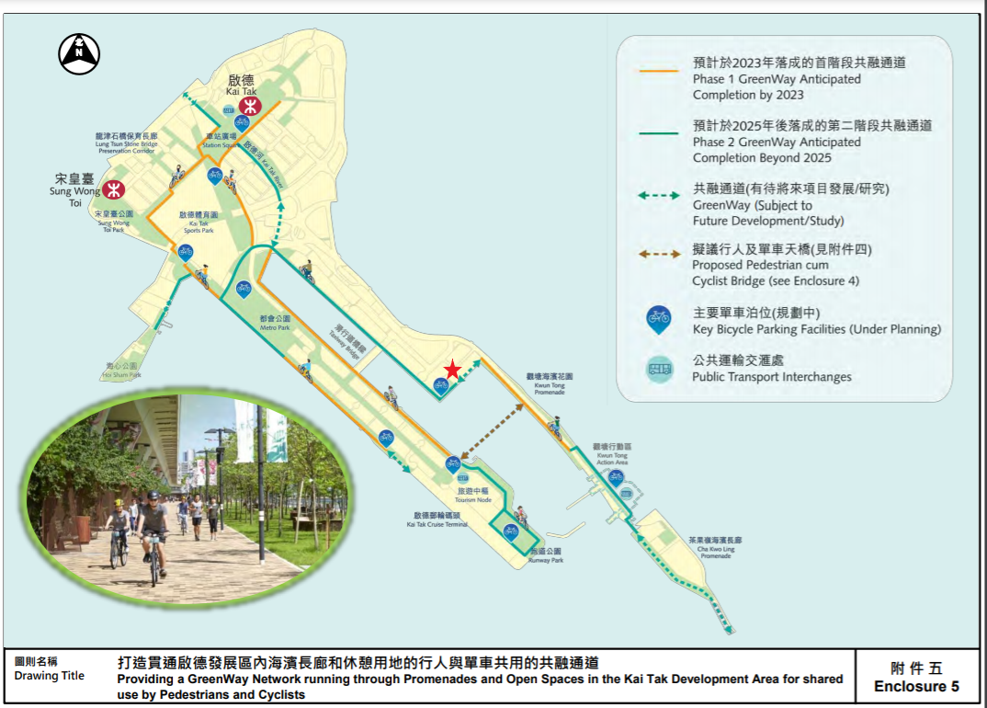
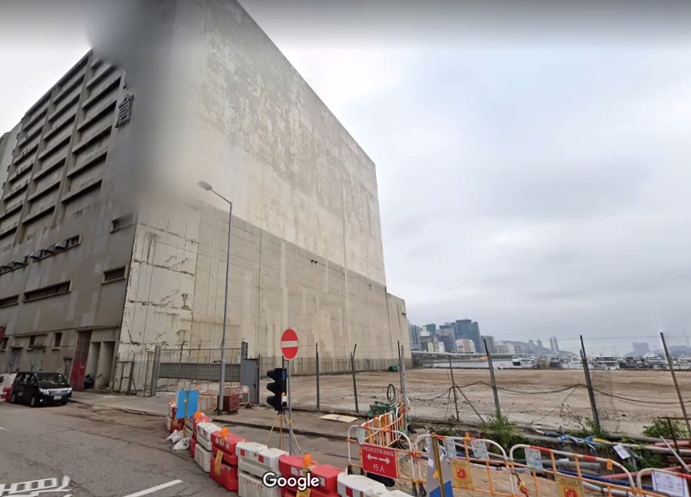
New Car Park Example
Street View
Future GreenWay Plan by Government

Slide 10
SOLUTIONS
Add road acccess restriction on the identified congestion hotspot (industrial area in Kwun Tong starting from Hoi Yuen Road), to reduce the numbers of private cars on road in peak hours.
X
1
Set up some new car parks far from the congestion roads and near the Green Way Network (an example).
2
P
Promote using e-scooters + multiple transport modes in a journey.
→ Set e-scooters renting service in the car parks.
→ Introduce an app helping e-scooter users to plan their journey.
3

Slide 11
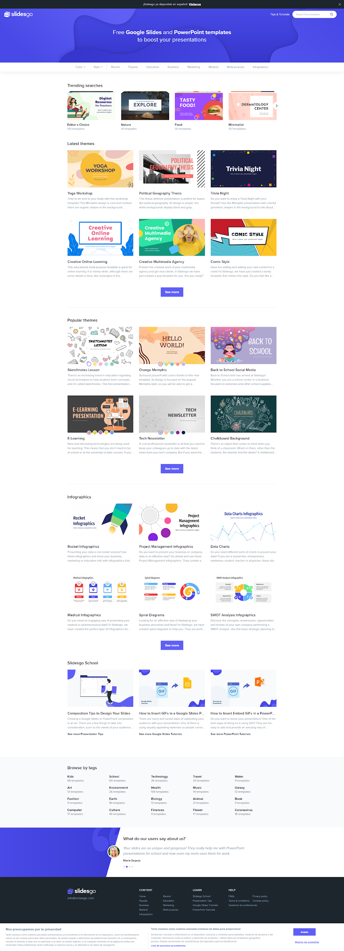
Smart Journey --Mobile App
P
🛴
Easy parking
E-scooter service
Using technology like image analysis, machine learning, AI on the real-time vacant parking space information, combining with the traffic congestion situation, help customers choose a right place to park.
(1) E-scooters rental service
(2) Journey planner combining other transport modes with e-scooters, and customers can choose the fastest or the properest way to get to the destination.
(3) Other services like e-scooters sales, maintenance, and license applying.

Slide 12
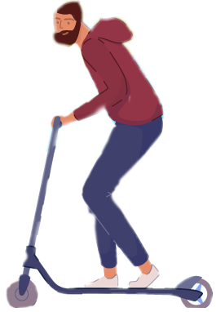
Model
P
RENT
🛴
🛴
🛴
🛴
🛴
🛴
🛴

Slide 13
CUSTOMER PROFILE
Private car drivers
E-scooter users
who want to look for car parks under the restriction hours or serious traffic congestion
who want to plan their journey with e-scooters or have alternative routes under heavy traffic

Slide 14
PROFIT MODEL
E-scooters rental income
RENTAL SERVICE
The revenue received by advertisers for placing advertisements in app
ADVERTISING
Pro+ features ...
MEMBER SERVICE

Slide 15
COMPETITIVE ANALYSIS
App
Function
Google Map
HKeMobility
Smart Journey
🛴
P
(in HK)

Slide 16

Prototype Showing in Tableau

Slide 17

THANKS
Do you have any questions?
team5@hkust.com

Slide 18
RESOURCES
PICTURES
p5: https://www.ekeo.gov.hk/walkablekwuntong/1st_stage_key.html
p7: https://www.google.com/maps/
p9: https://www.legco.gov.hk/yr20-21/english/panels/dev/papers/dev20210126cb1-447-5-e.pdf
DATA
p6: https://data.gov.hk/sc-data/dataset/hk-td-tis_7-traffic-flow-census

Slide 19
CONTRIBUTION
CHENG, Wing Kit
Problem Identification, Solution and Prototype Design, Progress Update
GAO, Jingqi
Prototype Design
WENG, Yuxuan
Problem Identification, Solution Design
MA, Xinyi
Data Collection
LEI, Lin
Data Collection, PPT, Presentation

